Slide 1
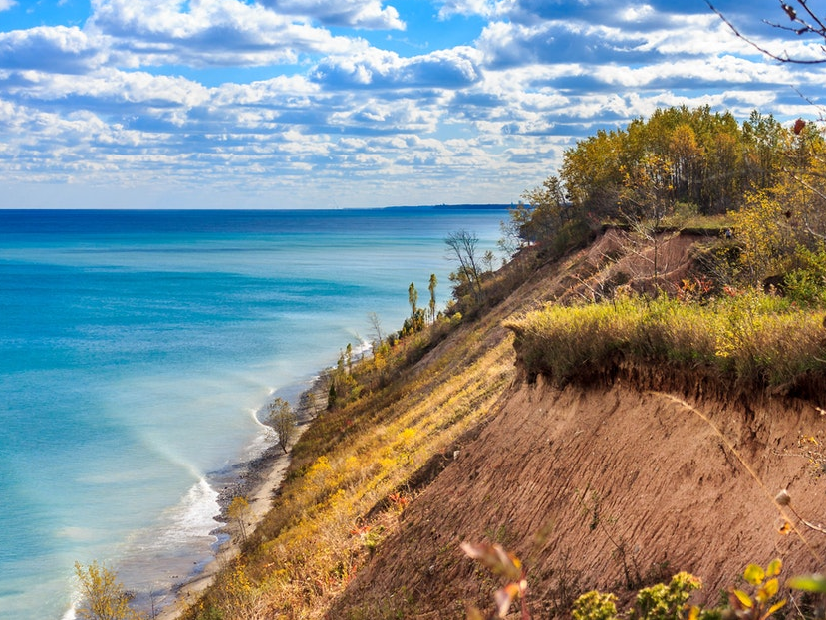
State of the Community Event January 25, 2023
Lester A. Bartel, Jr. Town of Grafton Chairman

Slide 2
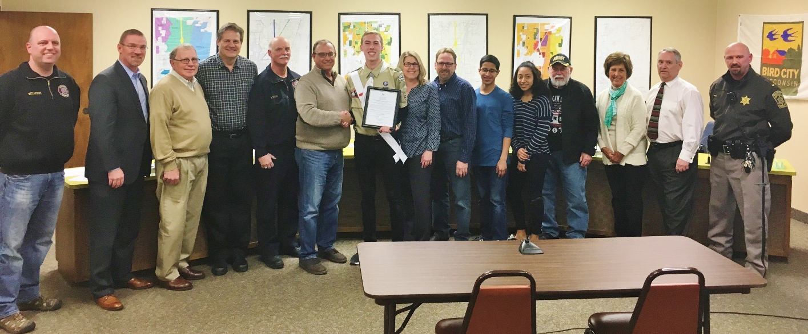
Warm Greetings
Town Chairman:
Lester A. Bartel, Jr.
Town Supervisors:
Tom Grabow, Paul Melotik,
Tom Sykora, Karron Stockwell

Slide 3
2022 Town Highlights
Did You Know? . . .
The Town of Grafton, located in the heart of Ozaukee County, consists of approximately 10,258 acres of land with a total 2021 assessed valuation of $705,827,630.
There are approximately 62 miles of roads within the Town of Grafton – 18 miles being under Federal, State, or County jurisdiction, and 44 miles being under Town of Grafton jurisdiction.

Slide 4
2022 Town Highlights
Fast Facts of a Growing Town
Median Age of a Town Resident – 48 Years
Median Income of a Town Household – $85,550 (2022)
97.5% of Town Residents Have a High School Diploma or Higher

Slide 5
2022 Town Highlights
Documented Growth
The Town of Grafton has experienced documented, consistent growth in both population and home values each year.
The Town has also noted an increase in the number of families with school age children – great for the GRAFTON SCHOOL DISTRICT!
The total assessed valuation of the Town of Grafton has increased $196,661,125 over the past 10 years.

Slide 6
2022 Town Highlights
Documented Growth in Assessed Valuation
2012 | $509,166,505
2013 | $515,992,375
2014 | $541,329,680
2015 | $543,148,036
2016 | $548,788,175
2017 | $586,247,004
2018 | $590,198,500
2019 | $601,047,700
2020 | $681,629,500
2021 | $696,406,743
2022 | $705,827,630

Slide 7
2022 – OLKA Trucking
We are excited to welcome OLKA Trucking and owner Oleh Zazulyak to the Town of Grafton. OLKA now occupies the former location of Calibre, Inc. With the help of Kathleen Schilling and Ozaukee County Economic Development, OLKA is the recent recipient of a Mainstreet Bounce-Back Grant.

Slide 8
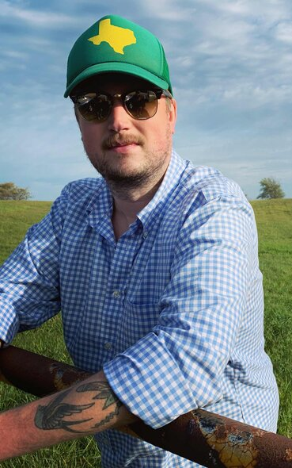
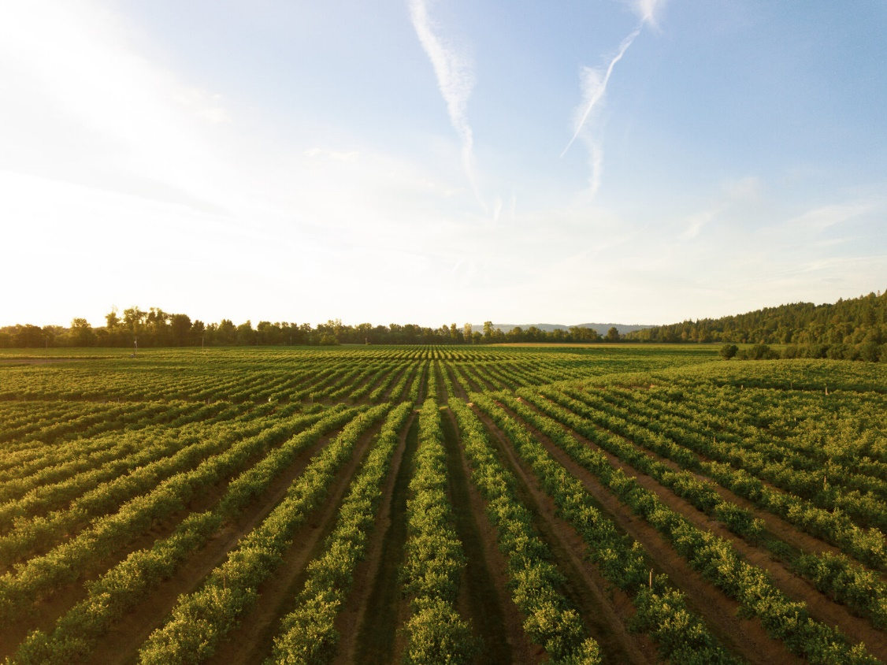
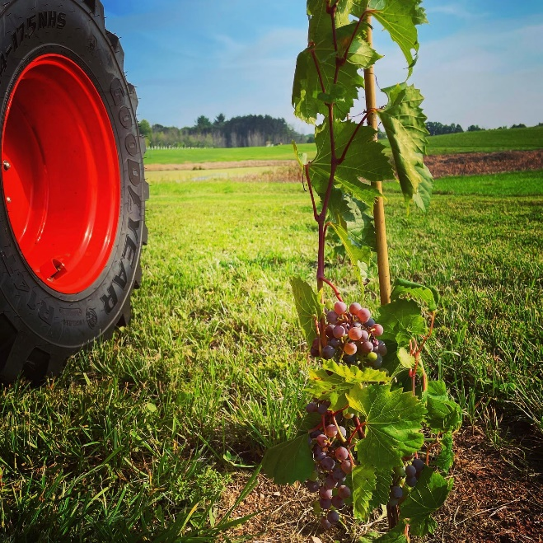
2022 Town Highlights – Continued Progress at Anton Vincent Winery
Providing Ozaukee County’s first full scale grape-to-glass winery and elevating Wisconsin winemaking by producing world class wines from local grapes. Anton Vincent Winery and has another successful season under its belt with an eye on construction.

Slide 9
2023 and Beyond –
Country View Subdivision
Country View Development, LLC, and President Matt Clapper have only two lots left in Phase Two. Keep your eyes open for Phase Three.

Slide 10
2023 and Beyond – StorageShopUSA™
In 2023 The Town welcomed Greg Thompson and StorageShopUSA™
Experience over the last 18 years and 22 developments has shown that 50% of the owners utilize the space for business purposes, 30% work workshops, and 20% for storage. Many utilize the space for all three reasons – the space is very functional and in high demand. A listing of the uses from a very recent StorageShopUSA™:
2- electrical contractor
1- plumbing contractor
2- security systems contractor
1-“coffee cart” operator
1- sets up trade shows
1- remodeling contractor
8- workshops
4- car collectors/enthusiast
6- personal storage

Slide 11
2023 and Beyond – New Town Hall
In 2022 The Town purchased the building at 1220 Fall Rd. previously belonging to Motorsports Composites. We hope to renovate and occupy the building by the end of 2023

Slide 12
What’s Next?
We will continue working to increase our budget allocation for roads. In 2022 the plan is to reconstruct Woodland & Crestview Drives. Improvement of our local infrastructure continues to be the major focus of your town board.
We will continue to support the Grafton Area Chamber of Commerce, the Grafton Fire Department, the Grafton Public Library, the Grafton School District, and the Village of Grafton through our great working relationships.

Slide 13
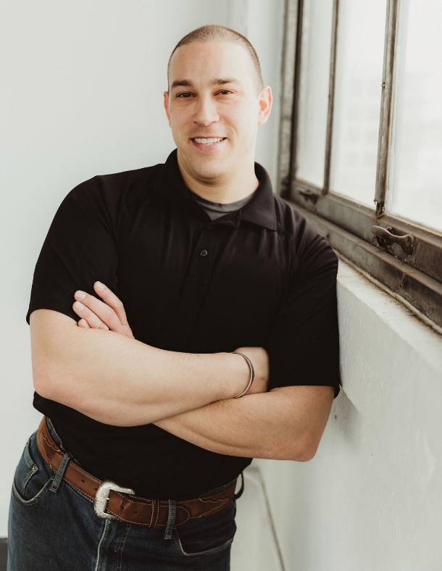
New Building Inspector
Our building inspector Rick Fellenz retired in June. The Town of Grafton welcomes our new Building Inspector and Town of Grafton Resident, Jason Katz.

Slide 14
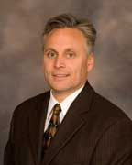
Retirement of John Hanson
The Town of Grafton thanks John for his 22 years of service. His care and concern for the Library and its position in the Grafton Community will never be replaced.

Slide 16
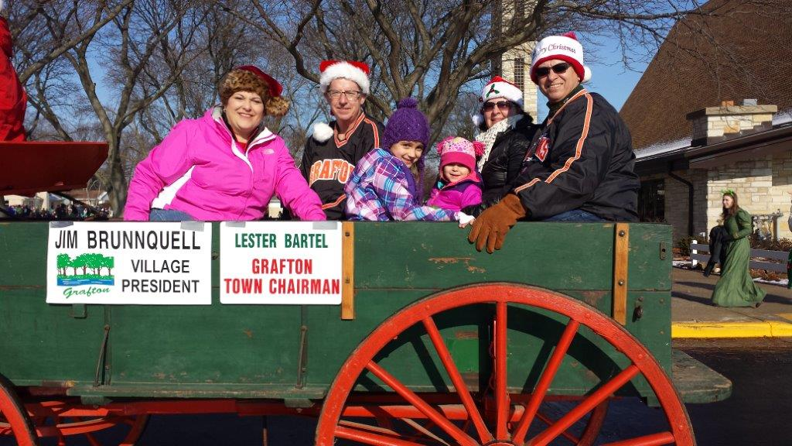
Jim Brunnquell

Slide 17
Jim Brunnquell

Slide 18
As always, thank you to the Grafton Chamber of Commerce [Pam king, Sarah McCraw, Elizabeth Mueller, and Chamber president, Sean Fahey] for putting this annual event together.

